Slide 1
University after Technical College Pathway in Russia: a Route to Social Mobility or Reproduction of Social Inequality? Образовательный путь "в университет через колледж": мобильность без рисков или механизм воспроизводства социального неравенства?
Gordey Yastrebov
EUROPEAN UNIVERSITY INSTITUTE (FLORENCE),
HIGHER SCHOOL OF ECONOMICS (MOSCOW)
YULIYA KOSYAKOVA
INSTITUTE FOR EMPLOYMENT RESEARCH (NUERNBERG)
DMITRIY KURAKIN
HIGHER SCHOOL OF ECONOMICS (MOSCOW)

Slide 2
ORIGINS OF THE INQUIRY (1)
comprehensive study of reproduction of social inequality in Russia’s system of secondary education – country case contribution to eduLIFE project (led by prof. H.-P. Blossfeld)
Kosyakova Y., Yastrebov G., Yanbarisova D., Kurakin D. The Reproduction of Social Inequality within the Russian Educational System, in: Models of Secondary Education and Social Inequality: An International Comparison. Edward Elgar Publishing, 2016
interplay between primary/secondary effects of social background and formal/informal institutional differentiation in Russia's educational system
similar to Bessudnov & Malik (2015), but looking beyond school continuation decisions and distinguishing several qualitatively different educational careers (accounting for less visible dimensions of institutional differentiation both before and after 9th grade)

Slide 3
ORIGINS OF THE INQUIRY (2)
in the classification of educational choices higher education after vocational education pathway (or VE-HE for short) emerged as a relatively popular strategy
who uses it? why is it being used? why it exists? how does it interact with social inequality?
first findings presented in 2015 (RC28 meeting @ Tilburg University, Inequalities Reconsidered conference @ University of Bern)
in 2015 Alexandrov, Tenisheva & Savelieva publish a paper on similar issues (to be discussed shortly)
current study readdresses the issue by critical examination of existing literature and by making use of the newly released TrEC data from the 4th wave

Slide 4
STRUCTURE OF PRESENTATION
Brief review of existing literature
what we already know from existing evidence in other countries
what can we additionally learn from Russia?
Theoretical underpinnings & hypotheses
Empirical findings
Conclusions & venues of further inquiries

Slide 5
VE-HE PATHWAY: RELEVANCE
relevance of VE-HE pathway
facilitating access to higher education in the context educational expansion (e.g. Bandias, Fuller & Pfitzner, 2011; Pilz 2012)
facilitating social mobility by allowing more flexibility in educational careers (e.g. Field, Kuczera & Pont 2007; Werfhorst & Mijs 2010)

Slide 6
VE-HE PATHWAY: CHALLENGES (1)
substantial entry barriers
strong institutional barriers, competency-based orientation of VE versus theoretical academic orientation of HE, differences in approaches to teaching and assessment of progress, problematic credit transfers, etc. (Brown, Moerkamp & Voncken 1999; Cantwell & Scevak 2004; Hodgson & Spours 2010; O’Shea, Lysaght & Tanner 2012)
cultural and psychological barriers associated with economic pressures and previous experiences of average academic record typical for the social composition of VE learners (Cantwell & Scevak 2004; Aynsley & Crossouard 2010)

Slide 7
VE-HE PATHWAY: CHALLENGES (2)
questionable returns
increased risks of interrupted educational careers (Brown et al. 1999)
difficulties securing adequate employment and generally modest labor market returns (Büchel & Helberger 1995)
generally lower quality HE, because VE institutions are often less organizationally connected to elite universities and because VE students tend to self-select into less prestigious HE institutions (Hoelscher, Hayward, Ertl & Dunbar‐Goddet 2008; Moodie & Wheelahan 2009; O’Shea et al. 2012)

Slide 8
VE-HE PATHWAY and SOCIAL INEQUALITY (1)
evidence from countries with both comprehensive and tracked educational systems
Australia: no difference in social composition between students accessing HE via more traditional pathways and HE students with vocational backgrounds (Moodie & Wheelahan 2009)
USA: similar findings when exploring transfers from two-year community colleges to four-year colleges, when explicitly controlling for previous academic record (e.g. Dougherty & Kienzl 2006)
Netherlands: the likelihood of upward track mobility in school is positively associated with social background (Tieben 2011)

Slide 9
VE-HE PATHWAY and SOCIAL INEQUALITY (2)
Germany: a remarkable case
a handful of studies on ‘double qualifications’ (VE-HE pathway in Germany) (Büchel & Helberger 1995; Becker & Hecken 2009; Bellman & Janik 2010; Hartlaub & Schneider 2012)
‘double qualifications’ as a strategy particularly widespread among average performing students from middle class families (Becker & Hecken 2009, Hartlaub & Schneider 2012)
‘insurance’ (Büchel & Helberger 1995) or ‘safety net’ thesis (Shavit & Muller 2000): VE qualifications as means of securing position on the labor market that can safeguard against possible failures in HE
‘diversion’ thesis (Shavit & Muller 2000, Hillmert & Jacob 2003): at comparable levels of ability students from less advantaged backgrounds are ‘diverted’ to VE, because for them relative risks of continuing in HE are higher

Slide 10
VE-HE PATHWAY and SOCIAL INEQUALITY (2)
Germany: a remarkable case
explicit recognition of interactive relationship between social background and academic performance in shaping the choice of VE-HE pathway (Becker & Hecken 2009, Hartlaub & Schneider 2012)
highly specific context of these studies:
strong connection between educational system and labor market + strong vocational training (justify the insurance thesis)
highly tracked educational system: VE-HE is available almost exclusively to Abitur holders, i.e. students who have completed academic track and thus made themselves eligible to HE
this is very different from the Russian context…

Slide 11
VE-HE PATHWAY IN RUSSIA (1)
Institutional context surrounding VE-HE pathway in Russia
track choice decisions are made in the 9th grade
traditional academic track entitling to HE requires 2 additional years of studies and successful passage of the Unified State Examination (USE)
however, vocational track after 9th grade does not block the possibility of enrolling in HE programs – on the contrary, transition from VE to HE can be a universally attractive alternative, because
it provides vocational level qualifications (although a much poorer guarantee than in Germany owing to a weaker link between educational system and labor market in Russia (Gimpelson, Kapelyushnikov et al. 2009))

Slide 12
VE-HE PATHWAY IN RUSSIA (2)
it can spare one year of studies in HE (via credit transfers)
it is less selective with regard to student intake
admission rules to HE for VE graduates can also be less challenging compared to admission rules for traditional academic track takers:
legally established optionality of USE certification in admission (responsibility of HE providers)
institutional adaptation of the system: agreements between VE providers and HE institutions, HE institutions with faculties providing VE education, etc. (Alexandrov et al. 2015)

Slide 13
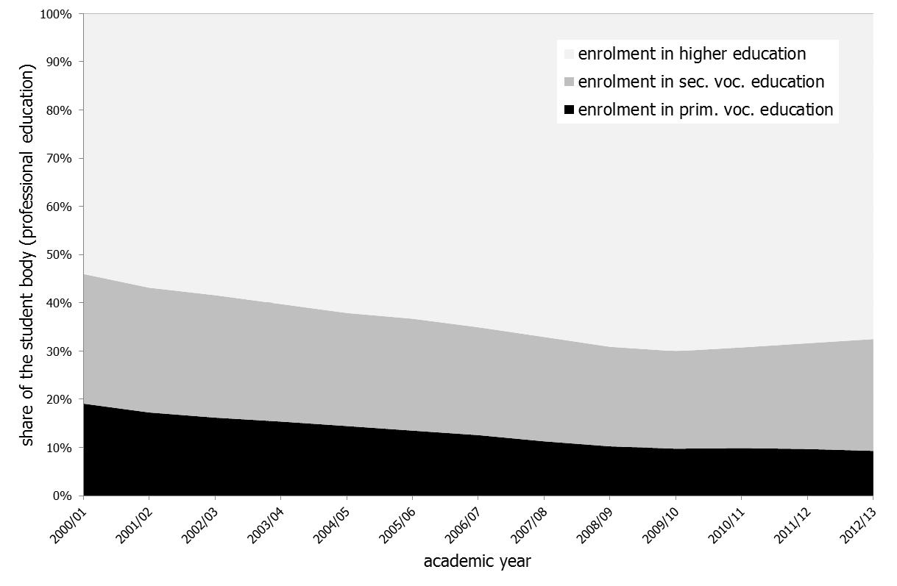
USE REFORM
2009: USE introduced
nationwide
Source: Federal State Statistics Service of Russia

Slide 14
VE-HE PATHWAY IN RUSSIA (3)
Alexandrov et al. (2015)
recognize the attractiveness of the VE-HE pathway in Russia on similar grounds
conceive VE-HE pathway serves as channel of 'safe mobility' for children with average performance in school, and whose parents also occupy intermediary positions in socioeconomic hierarchy
build on the theory of relative risk aversion (RRA) (Breen, Goldthorpe 1997):
the main motive behind educational decisions – avoiding downward social mobility, rather than maximizing social status (hence the tendency towards social reproduction)
VE-HE pathway in Russia indeed enables less risky route to HE, and is therefore more ‘affordable’ to the groups specified

Slide 15
THEORY: BEYOND RRA
however, RRA alone overlooks an important part of the story regarding how VE-HE pathway interacts with social inequality
theory of compensatory advantage of social background (CA) (Bernardi 2012, 2014)
complementary to RRA in the sense that it also recognizes status maintenance as the main motive behind educational decisions
whenever a group of individuals is exposed to disadvantage, inequality in that group is likely to increase, because individuals with more advantaged backgrounds tend to be more equipped to cope with difficulties
VE-HE pathways as a specific rational strategy triggered in disadvantaged contexts threatening status maintenance

Slide 16
HYPOTHESES (1)
two types of unfavorable circumstances potentially impeding status reproduction are in focus of our study
individual circumstances: lower ability threatening access to HE via traditional pathways
structural opportunities: undeveloped educational infrastructure impeding access to HE via traditional pathways

Slide 17
HYPOTHESES (2)
following the logic of CA theory
we expect more advantaged families to be particularly more likely to opt for VE-HE pathway (compared to less advantaged families)…
if children demonstrate insufficient academic performance
in the context of lower developed areas (also in Alexandrov et al. 2015)
…and to be less likely to opt for it in more favorable contexts.
general prediction from CA
greater social gaps with regard to educational choice in less favorable contexts

Slide 18
DATA
Russian Panel Study of Trajectories in Education and Careers (TrEC)
TIMSS 2011 stratified sample (Wave 0) of 8th graders: N = 4,893 students in 210 schools in 42 regions
primary sources:
Wave 0 (TIMSS 2011, 8th gr.)
Wave 1.1 (PISA 2012, 9th gr.)
Wave 4 (N = 3,618, i.e. 26% attrition from the original sample, weights applied to achieve original representation)
various auxiliary data to complete information on educational pathways and background of students:
Wave 1 (2012)
Wave 2 (2013)

Slide 19
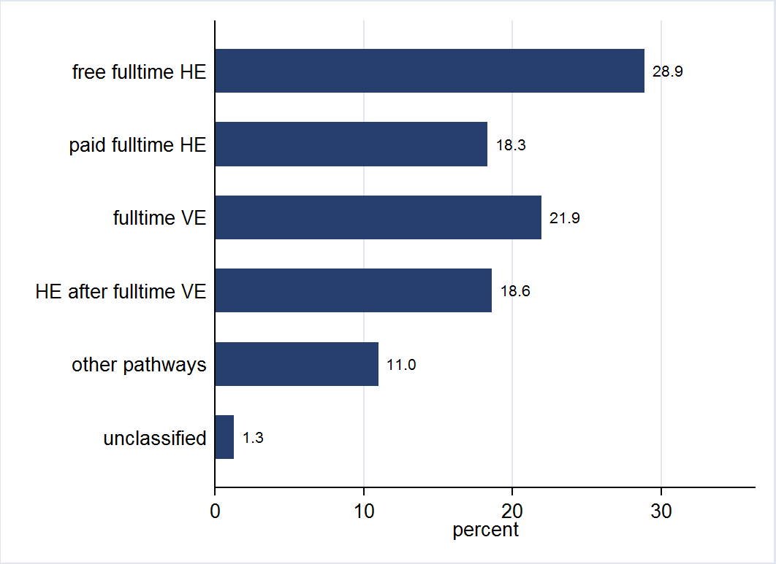
DISTRIBUTION OF MAIN EDUCATIONAL PATHWAYS

Slide 20
SOME FACTS ABOUT VE-HE PATHWAY (1)
74% of the VE-HE takers are students of free full-time vocational education
successful transition to higher education – 12% of VE-HE takers
among them 70% report enrolment in paid part-time education
11% of VE-HE takers continue (or intend to continue) studies in high ranking HE institutions (REA university ranking 2015)
22% among students in paid full-time higher education,
30% among students in free full-time higher education
20% of VE-HE takers plan access to higher education via USE and 53% report they can avoid it

Slide 21
SOME FACTS ABOUT VE-HE PATHWAY (2)
VE orientation | educational pathway
 | full-time VE | HE after full-time VE
STEM professions (e.g. in electricity works, IT industry, geology, transportation, architecture, etc.) | 63% | 49%
Medical professions | 12% | 11%
Service sector professions (e.g. economists, lawyers, social workers, teachers, etc.) | 24% | 38%
Other | 2% | 2%
difference statistically significant at 5% alpha-level

Slide 22
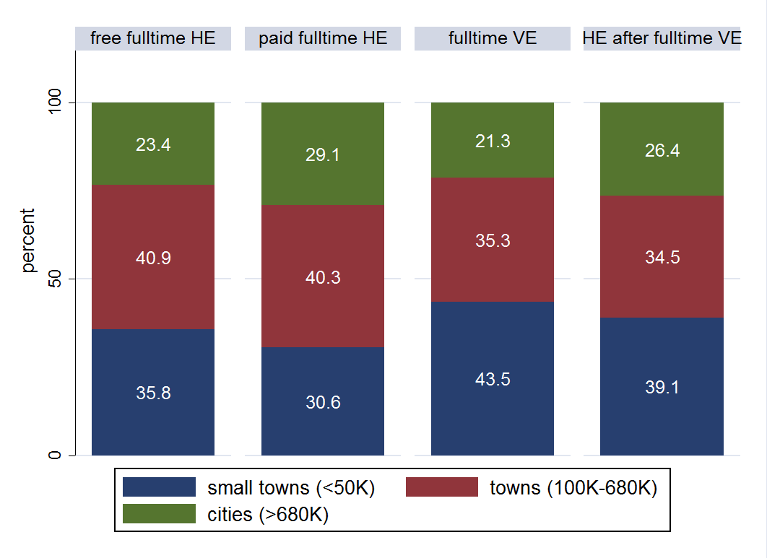
VE-HE PATHWAY VS OTHER PATHWAYS (RESIDENCE)
all differences statistically significant at 5% alpha-level except ‘fulltime VE’ and ‘HE after fulltime VE’

Slide 23
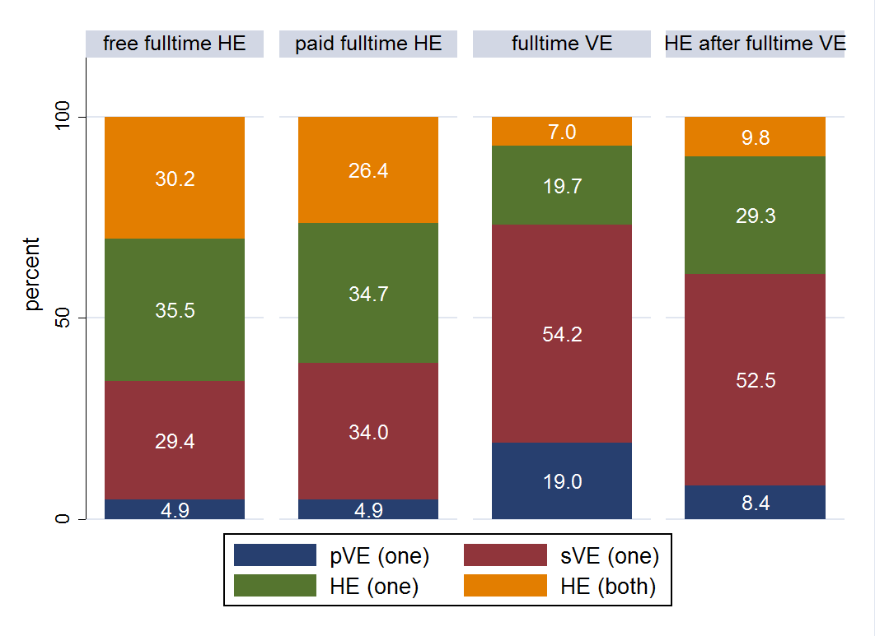
VE-HE PATHWAY VS OTHER PATHWAYS (BACKGROUND)
all differences statistically significant at 5% alpha-level except ‘free fulltime HE’ and ‘paid fulltime HE’

Slide 24
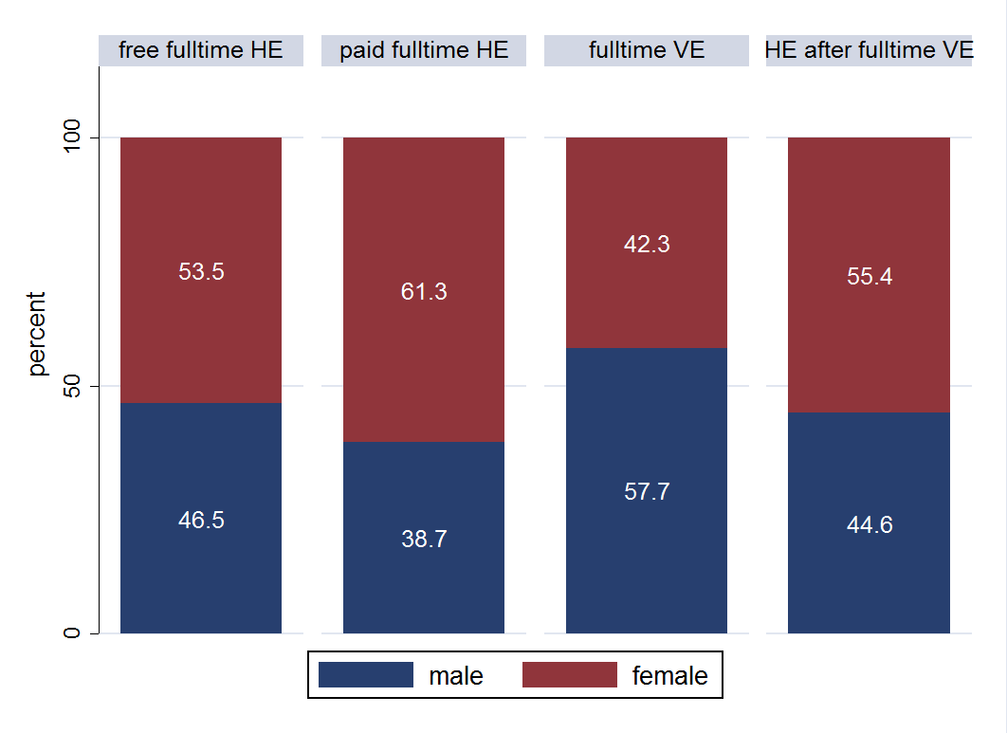
VE-HE PATHWAY VS OTHER PATHWAYS (GENDER)
all differences statistically significant at 5% alpha-level except ‘free fulltime HE’ and ‘HE after fulltime VE’

Slide 25
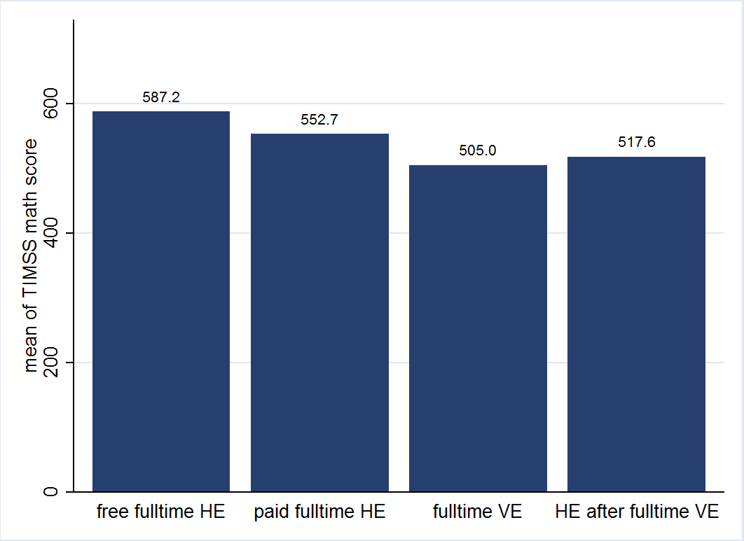
VE-HE PATHWAY VS OTHER PATHWAYS (ABILITY)
all differences in means statistically significant at 5% alpha-level

Slide 26
MULTIVARIATE ANALYSES: MODELS
MULTINOMIAL LOGIT MODELS:
PATHWAY CHOICE = f ( SEX, RESIDENCE, ABILITY, EDUCATION OF PARENTS, ABILITY × EDUCATION OF PARENTS )
PATHWAY CHOICE = f ( SEX, RESIDENCE, ABILITY, EDUCATION OF PARENTS, RESIDENCE × EDUCATION OF PARENTS )
VARIABLES:
education of parents
lower – maximum secondary vocational education
higher – at least one parent with higher education
residence
small towns (towns and villages, less than 50 thsd citizens)
towns (towns, from 50 to 680 thsd citizens)
cities (cities, more than 680 thsd citizens, incl. Moscow and St. Petersburg)
ability measures
TIMSS math & science, PISA reading, math & science
all findings robust, whichever measure is used

Slide 27
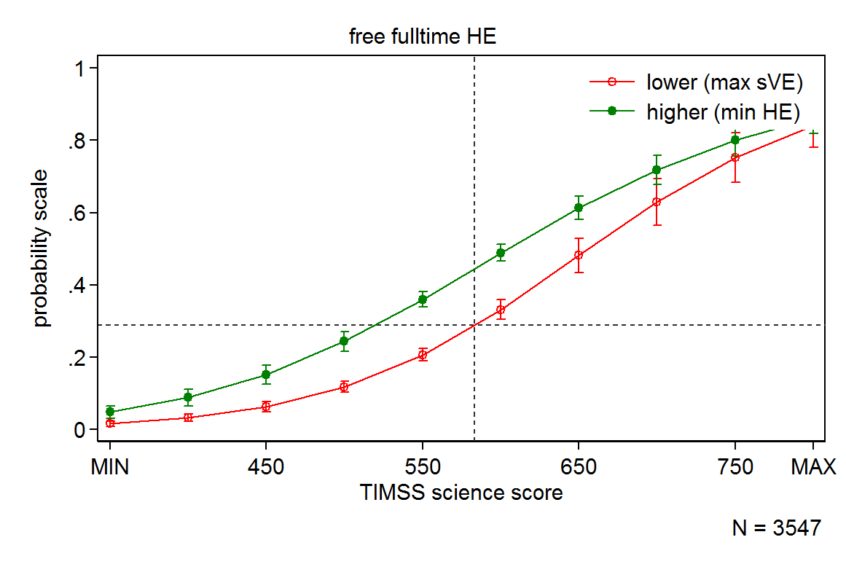
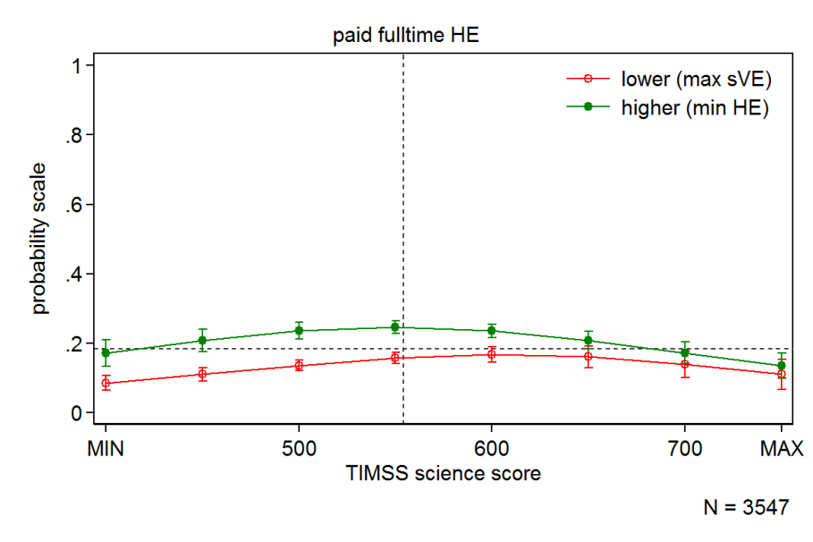
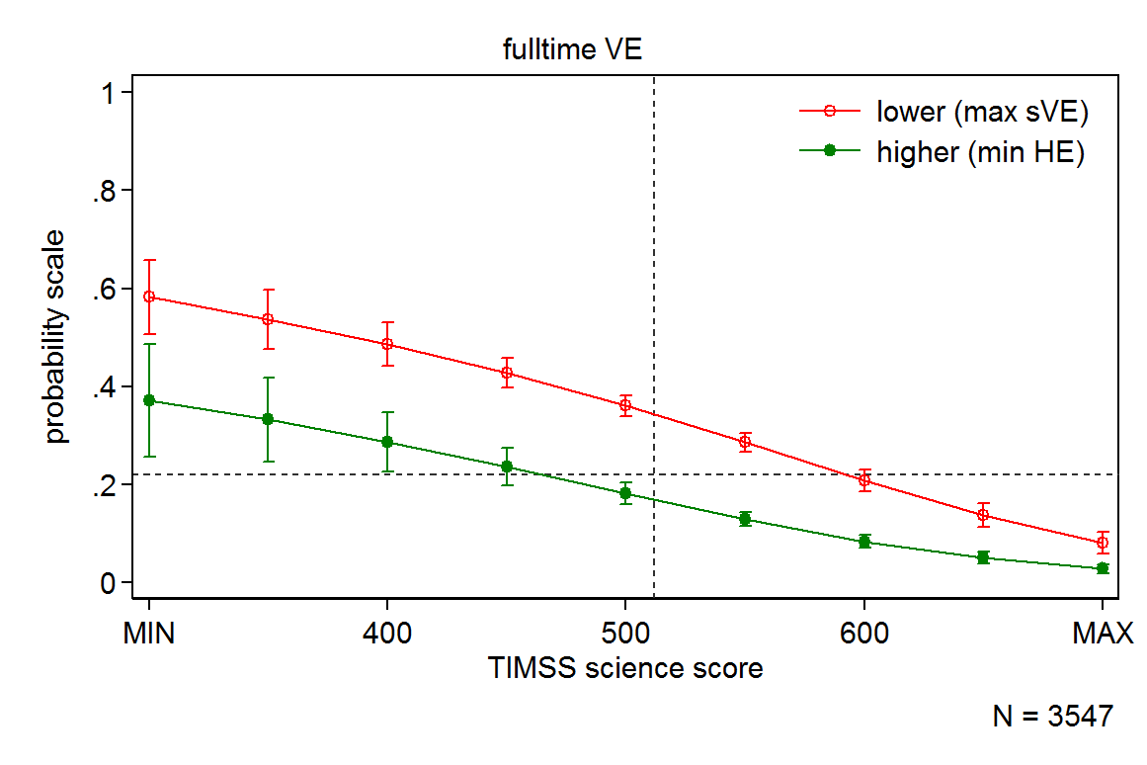
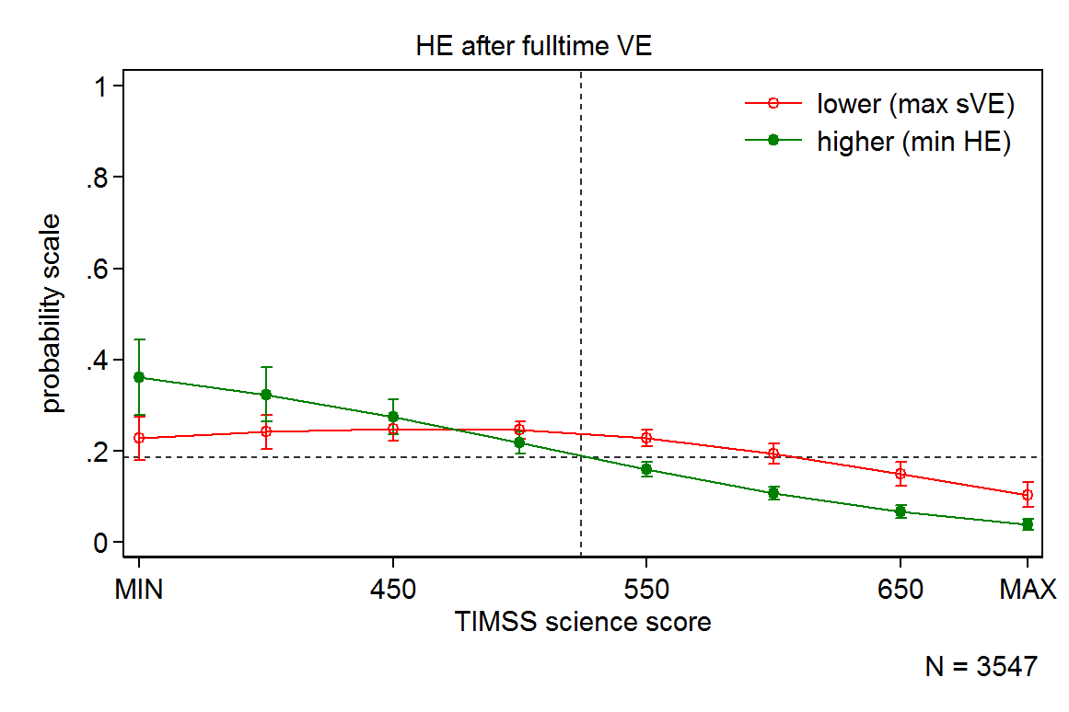
PROBABILITY OF PATHWAY CHOICE BY ABILITY AND BACKGROUND (1)
horizontal dotted lines – unconditional probabilities of pathway choice
vertical dotted lines – choice-specific mean ability score (unconditional)
MIN and MAX – choice-specific extremes of ability scores of students from most advantaged backgrounds

Slide 28
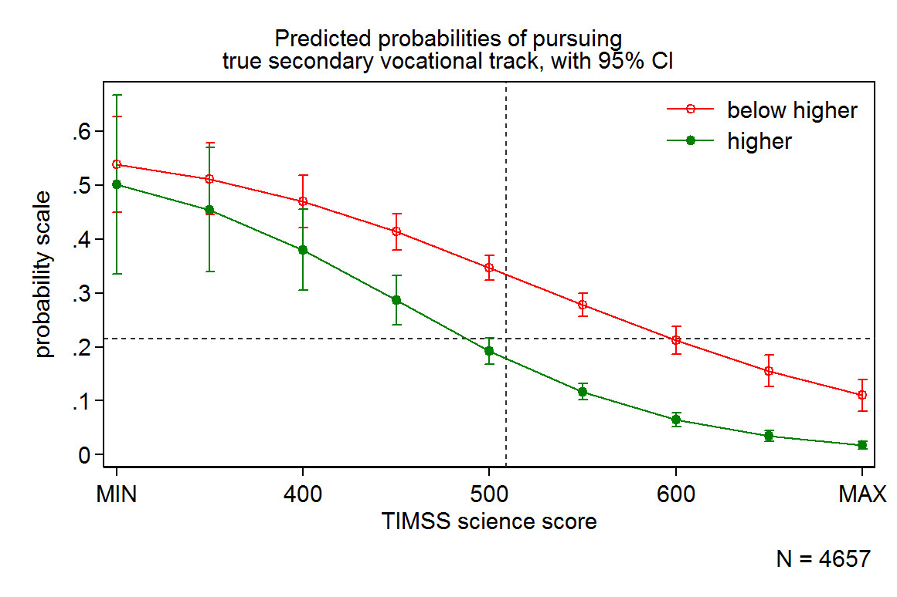
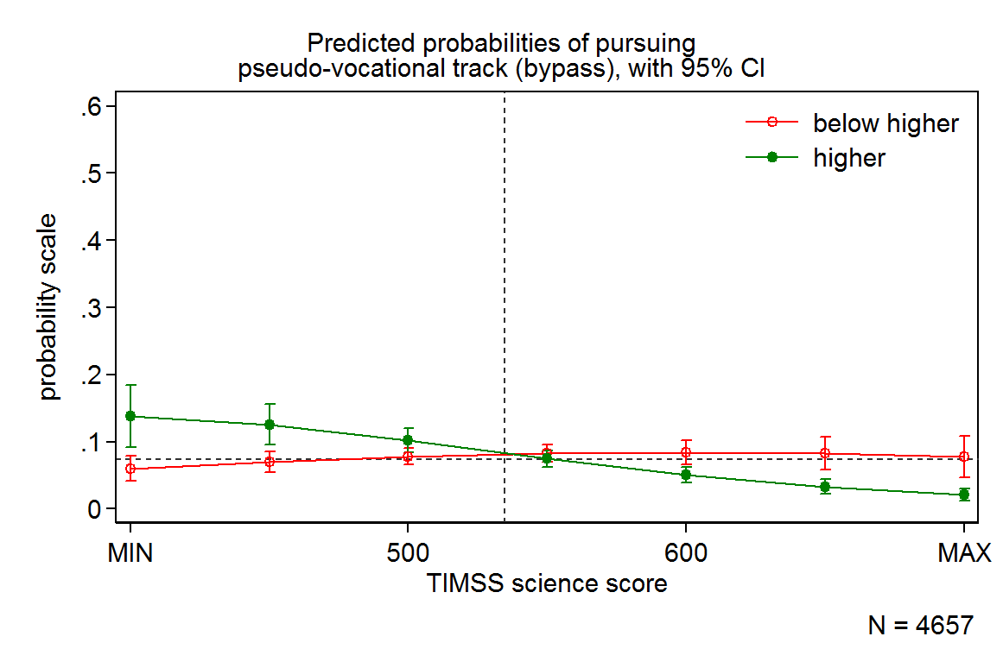
PROBABILITY OF PATHWAY CHOICE BY ABILITY AND BACKGROUND (2)
our earlier findings (choice aspirations after 9th grade):
the patterns of inequality and corresponding strategies seem to persist, despite the fact that only 64% of initial aspirations were fulfilled
however, formal tests of statistical significance no longer allow rejecting the hypothesis of null interaction between ability and background (PISA measures are exception)
fulltime VE
HE after fulltime VE
lower (max sVE)
higher (min HE)
lower (max sVE)
higher (min HE)
horizontal dotted lines – unconditional probabilities of pathway choice
vertical dotted lines – choice-specific mean ability score (unconditional)
MIN and MAX – choice-specific extremes of ability scores of students from most advantaged backgrounds

Slide 29
Pathways by ability and background: highlights
strong secondary effects of social background in pathway choice
children of higher educated parents are more likely to select into pathways leading to HE, while children of lower educated parents are more likely select into pathways ending with VE
ability-driven selection into pathways
positive with regard to state-funded fulltime HE and negative with regard to fulltime VE
selection into privately funded HE is less sensitive to ability, but seems to favor students with average academic performance
VE-HE pathway
eases access to higher education for low performing students, but children of higher educated parents benefit the most

Slide 30
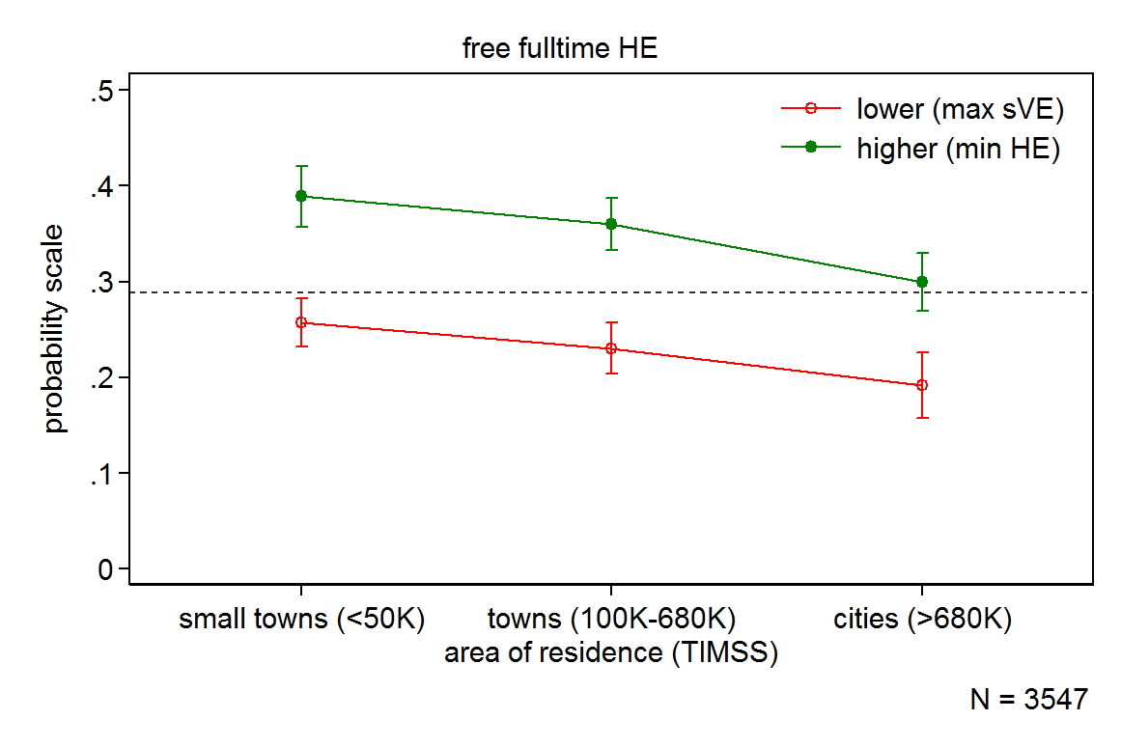
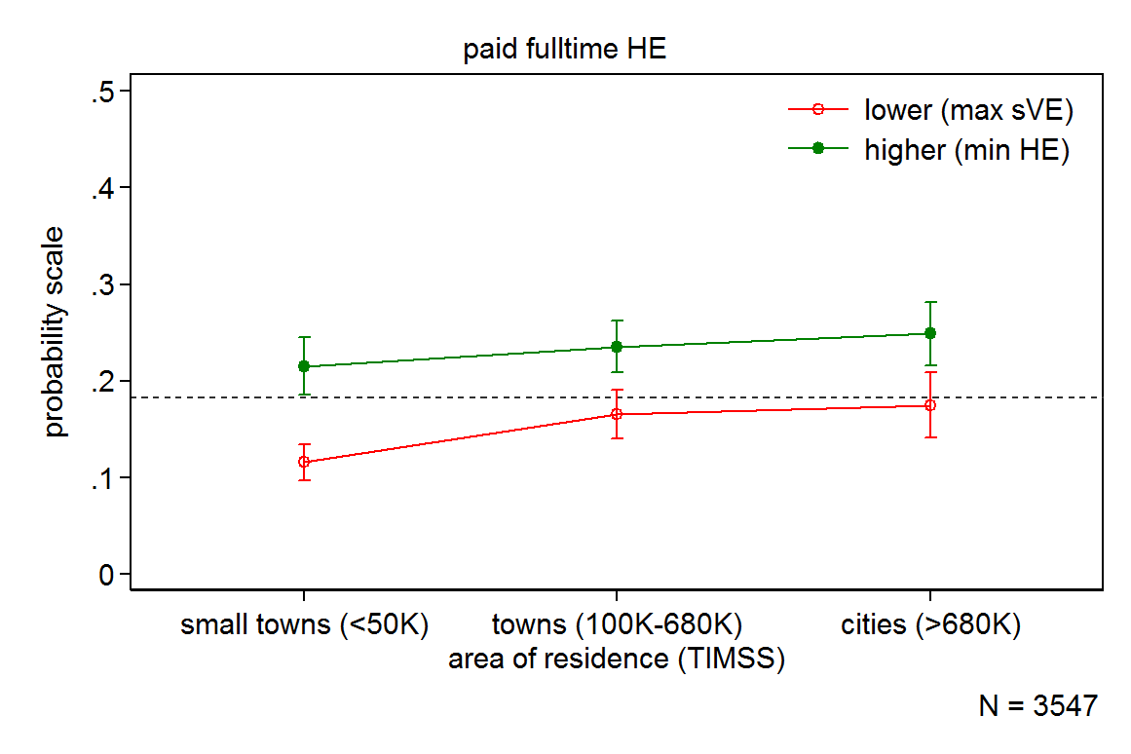
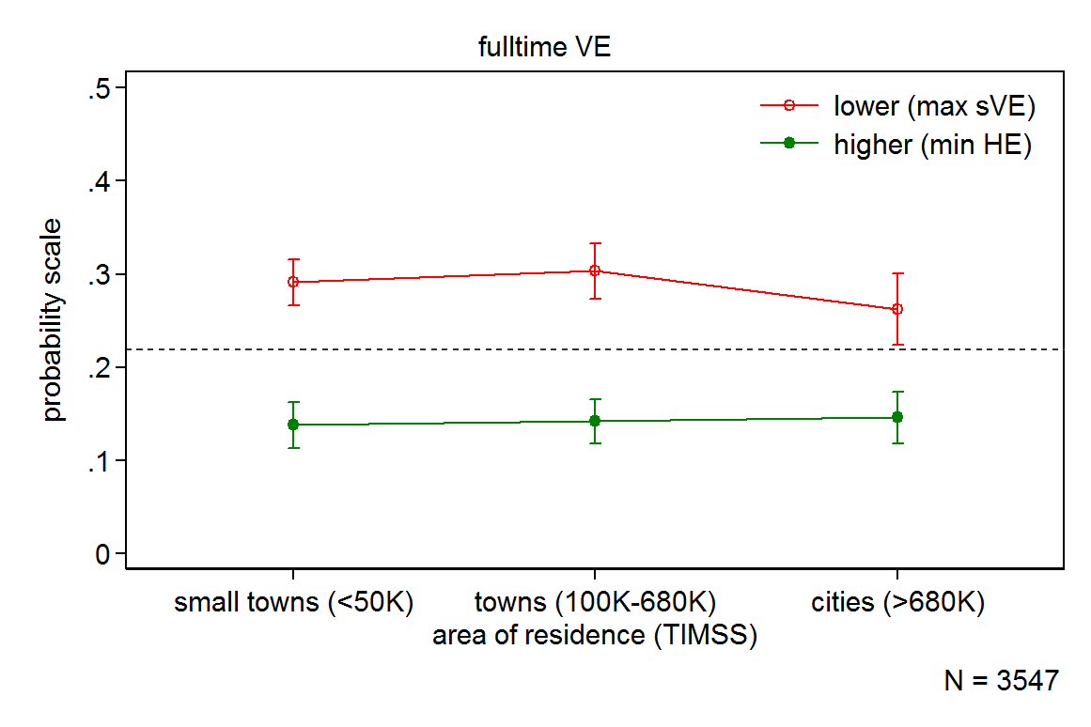
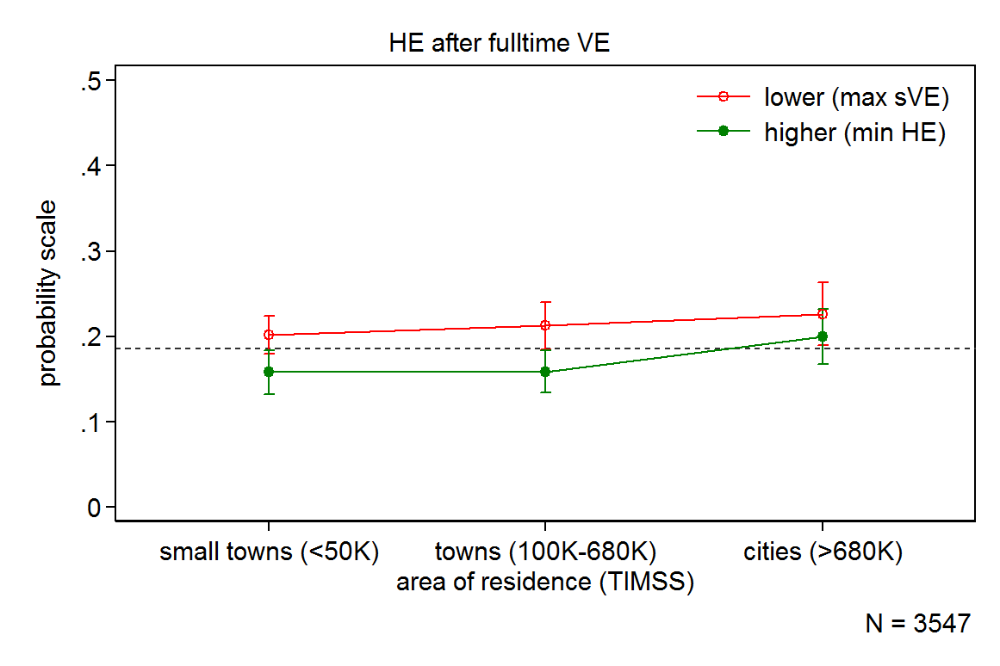
PROBABILITY OF PATHWAY CHOICE BY RESIDENCE AND BACKGROUND
horizontal dotted lines – unconditional probabilities of pathway choice

Slide 31
Pathways by RESIDENCE and background: highlights
children from less developed areas appear to enjoy advantage in direct access to state-funded fulltime HE
although it could be that it is the only type of higher education they can afford… (mind the opposite situation with regard to privately funded fulltime HE)
secondary effects of social background appear to weaken in cities
although it mostly concerns representation in VE
besides, the reduction in inequality is not statistically substantial
VE-HE pathway
selection into this pathway appears to be equally sensitive to social background regardless of the area (although this conclusion rests on statistically insignificant results)

Slide 32
CONCLUSIONS (1)
VE-HE pathway – a route to social mobility or reproduction of social inequality?
whereas the pathway indeed eases access to HE for children of less educated parents, the ones who appear to benefit the most are low performing children of more educated parents!
RRA theory
consistent with evidence
strong presence of secondary effects of social background
CA theory
consistent with evidence (albeit less robust)
secondary effects of social background tend to increase in case of exposure to disadvantage

Slide 33
CONCLUSIONS (2)
Policy implications
the system of USE was implemented with explicit purposes
promoting equality of opportunity in access to HE (eradicating arbitrariness of admissions to HE, including the system of pre-HE training, private tutoring, etc.)
promoting efficiency of the educational system (meritocracy)
both functions appear to be under threat due to 'attractive' features of VE-to-HE pathway as it currently exists in Russia
Possible challenge
VE and (lower quality) HE providers could have a serious stake in maintaining the status quo, because VE-HE pathway maintains their survival (competition for students and funding)

Slide 34
LIMITATIONS AND VENUES OF FUTURE RESEARCH
sample attrition
statistical power and validity of results
background information
TIMSS/PISA – very limited
other TrEC waves – severe attrition and a lot of missing information
future waves
from aspirations to actually fulfilled strategies
more information on the ‘quality’ of choice and its impact on labor market outcomes
qualitative research
in-depth information to explicate the true motives and strategies of children and parents finding themselves in different circumstances (e.g. lack of motivation and ability in advantaged backgrounds)

Slide 35
THANK YOU!

Slide 36
APPENDIX 1: MODEL ABILITY X BACKGROUND (1)
Multinomial logistic regression Number of obs = 3547
Wald chi2(24) = 652.01
Prob > chi2 = 0.0000
Log pseudolikelihood = -5086.4893 Pseudo R2 = 0.0831
---------------------------------------------------------------------------------------
| Robust
edupat2 | Coef. Std. Err. z P>|z| [95% Conf. Interval]
----------------------+----------------------------------------------------------------
free_fulltime_HE | (base outcome)
----------------------+----------------------------------------------------------------
paid_fulltime_HE |
ses2 |
higher (min HE) | -.7972342 .9829662 -0.81 0.417 -2.723813 1.129344
npach_TIMSSsci | -.0082506 .0013842 -5.96 0.000 -.0109637 -.0055375
|
ses2#c.npach_TIMSSsci |
higher (min HE) | .0012559 .0017321 0.73 0.468 -.0021391 .0046508
|
1.npsex | .2057737 .1034778 1.99 0.047 .002961 .4085864
|
residence |
towns (100K-680K) | .3024208 .1199545 2.52 0.012 .0673143 .5375273
cities (>680K) | .546889 .1353062 4.04 0.000 .2816937 .8120843
|
_cons | 3.896142 .7782863 5.01 0.000 2.370729 5.421555
----------------------+----------------------------------------------------------------
fulltime_VE |
ses2 |
higher (min HE) | -2.025109 1.034201 -1.96 0.050 -4.052106 .0018889
npach_TIMSSsci | -.0160933 .0012838 -12.54 0.000 -.0186095 -.013577
|
ses2#c.npach_TIMSSsci |
higher (min HE) | .0011737 .001865 0.63 0.529 -.0024817 .0048291
|
1.npsex | -.7295199 .1076131 -6.78 0.000 -.9404376 -.5186022
|
residence |
towns (100K-680K) | .1296843 .120747 1.07 0.283 -.1069754 .366344
cities (>680K) | .2640175 .1443969 1.83 0.067 -.0189953 .5470303
|
_cons | 9.431253 .7115068 13.26 0.000 8.036725 10.82578
----------------------+----------------------------------------------------------------

Slide 37
APPENDIX 1: MODEL ABILITY X BACKGROUND (2)
continued:
----------------------+----------------------------------------------------------------
HE_after_fulltime_VE |
ses2 |
higher (min HE) | -.1763999 .9898041 -0.18 0.859 -2.11638 1.76358
npach_TIMSSsci | -.0127766 .0012836 -9.95 0.000 -.0152924 -.0102609
|
ses2#c.npach_TIMSSsci |
higher (min HE) | -.0013448 .0017717 -0.76 0.448 -.0048173 .0021278
|
1.npsex | -.1439104 .1072193 -1.34 0.180 -.3540565 .0662356
|
residence |
towns (100K-680K) | .1235461 .1232659 1.00 0.316 -.1180505 .3651428
cities (>680K) | .4832961 .1405122 3.44 0.001 .2078972 .7586949
|
_cons | 7.04673 .7161932 9.84 0.000 5.643017 8.450443
----------------------+----------------------------------------------------------------
other_pathways |
ses2 |
higher (min HE) | -2.479125 1.159428 -2.14 0.032 -4.751562 -.2066886
npach_TIMSSsci | -.0140755 .0015224 -9.25 0.000 -.0170594 -.0110915
|
ses2#c.npach_TIMSSsci |
higher (min HE) | .0031892 .0020932 1.52 0.128 -.0009134 .0072917
|
1.npsex | -.4550298 .1256009 -3.62 0.000 -.7012031 -.2088565
|
residence |
towns (100K-680K) | -.1099779 .1452462 -0.76 0.449 -.3946552 .1746995
cities (>680K) | .3446081 .1621344 2.13 0.034 .0268305 .6623857
|
_cons | 7.403879 .8302606 8.92 0.000 5.776598 9.03116
---------------------------------------------------------------------------------------
. testparm 1o.ses2#c.npach_TIMSSsci
( 1) [free_fulltime_HE]1o.ses2#co.npach_TIMSSsci = 0
( 2) [paid_fulltime_HE]1.ses2#c.npach_TIMSSsci = 0
( 3) [fulltime_VE]1.ses2#c.npach_TIMSSsci = 0
( 4) [HE_after_fulltime_VE]1.ses2#c.npach_TIMSSsci = 0
( 5) [other_pathways]1.ses2#c.npach_TIMSSsci = 0
Constraint 1 dropped
chi2( 4) = 5.99
Prob > chi2 = 0.1996

Slide 38
APPENDIX 2: MODEL residence X BACKGROUND (1)
Multinomial logistic regression Number of obs = 3547
Wald chi2(28) = 720.23
Prob > chi2 = 0.0000
Log pseudolikelihood = -5048.9238 Pseudo R2 = 0.0899
----------------------------------------------------------------------------------------------------
| Robust
edupat2 | Coef. Std. Err. z P>|z| [95% Conf. Interval]
-----------------------------------+----------------------------------------------------------------
free_fulltime_HE | (base outcome)
-----------------------------------+----------------------------------------------------------------
paid_fulltime_HE |
ses2 |
higher (min HE) | .1166253 .1755851 0.66 0.507 -.2275151 .4607657
|
residence |
towns (100K-680K) | .4770876 .1879996 2.54 0.011 .1086153 .84556
cities (>680K) | .7298727 .2277626 3.20 0.001 .2834662 1.176279
|
ses2#residence |
higher (min HE)#towns (100K-680K) | -.3002909 .2426006 -1.24 0.216 -.7757794 .1751975
higher (min HE)#cities (>680K) | -.2834596 .282667 -1.00 0.316 -.8374768 .2705577
|
1.npsex | .2404317 .1035811 2.32 0.020 .0374164 .443447
npach_TIMSSmat | -.0076437 .0007717 -9.90 0.000 -.0091562 -.0061312
_cons | 3.434868 .4509541 7.62 0.000 2.551015 4.318722
-----------------------------------+----------------------------------------------------------------
fulltime_VE |
ses2 |
higher (min HE) | -1.387402 .1804072 -7.69 0.000 -1.740993 -1.03381
|
residence |
towns (100K-680K) | .1616102 .1624667 0.99 0.320 -.1568187 .4800391
cities (>680K) | .2220842 .2105141 1.05 0.291 -.1905158 .6346842
|
ses2#residence |
higher (min HE)#towns (100K-680K) | -.0345694 .2556551 -0.14 0.892 -.5356442 .4665053
higher (min HE)#cities (>680K) | .1763234 .3008195 0.59 0.558 -.4132721 .7659189
|
1.npsex | -.6369246 .1080129 -5.90 0.000 -.848626 -.4252233
npach_TIMSSmat | -.015553 .0008309 -18.72 0.000 -.0171815 -.0139245
_cons | 9.051067 .4617622 19.60 0.000 8.14603 9.956104
-----------------------------------+----------------------------------------------------------------

Slide 39
APPENDIX 2: MODEL residence X BACKGROUND (2)
continued:
-----------------------------------+----------------------------------------------------------------
HE_after_fulltime_VE |
ses2 |
higher (min HE) | -.8381921 .1757742 -4.77 0.000 -1.182703 -.4936811
|
residence |
towns (100K-680K) | .1766582 .1719964 1.03 0.304 -.1604485 .5137649
cities (>680K) | .4444849 .2130225 2.09 0.037 .0269685 .8620014
|
ses2#residence |
higher (min HE)#towns (100K-680K) | -.0764732 .2504928 -0.31 0.760 -.5674301 .4144837
higher (min HE)#cities (>680K) | .124619 .2891746 0.43 0.667 -.4421529 .6913909
|
1.npsex | -.0703062 .1080667 -0.65 0.515 -.2821131 .1415007
npach_TIMSSmat | -.0136072 .0008261 -16.47 0.000 -.0152264 -.011988
_cons | 7.389425 .4619181 16.00 0.000 6.484082 8.294768
-----------------------------------+----------------------------------------------------------------
other_pathways |
ses2 |
higher (min HE) | -.8866288 .201785 -4.39 0.000 -1.28212 -.4911375
|
residence |
towns (100K-680K) | -.2962361 .2080943 -1.42 0.155 -.7040934 .1116212
cities (>680K) | .3926797 .2366056 1.66 0.097 -.0710587 .8564181
|
ses2#residence |
higher (min HE)#towns (100K-680K) | .4323551 .2974325 1.45 0.146 -.150602 1.015312
higher (min HE)#cities (>680K) | -.0063177 .3308523 -0.02 0.985 -.6547764 .642141
|
1.npsex | -.3890264 .1260242 -3.09 0.002 -.6360292 -.1420236
npach_TIMSSmat | -.0121758 .0010274 -11.85 0.000 -.0141894 -.0101622
_cons | 6.394127 .5601356 11.42 0.000 5.296281 7.491972
----------------------------------------------------------------------------------------------------

Slide 40
APPENDIX 2: MODEL residence X BACKGROUND (3)
continued:
. testparm i.ses2#i.residence
( 1) [free_fulltime_HE]1o.ses2#2o.residence = 0
( 2) [paid_fulltime_HE]1.ses2#2.residence = 0
( 3) [fulltime_VE]1.ses2#2.residence = 0
( 4) [HE_after_fulltime_VE]1.ses2#2.residence = 0
( 5) [other_pathways]1.ses2#2.residence = 0
( 6) [free_fulltime_HE]1o.ses2#3o.residence = 0
( 7) [paid_fulltime_HE]1.ses2#3.residence = 0
( 8) [fulltime_VE]1.ses2#3.residence = 0
( 9) [HE_after_fulltime_VE]1.ses2#3.residence = 0
(10) [other_pathways]1.ses2#3.residence = 0
Constraint 1 dropped
Constraint 6 dropped
chi2( 8) = 8.15
Prob > chi2 = 0.4191

