Slide 1
Meaning Networks and Education: Putting Culture Into Survey Research
Tim Malacarne
Mount Holyoke College
Dmitry Kurakin
Higher School of Economics, Moscow

Slide 2
What do you want in life?

Slide 3
The tyranny of field-specific thinking

Slide 4
Problems with surveys and studies of culture

Slide 5
Our approach

Slide 6
Data
Trajectories in Education and Career (TrEc)
Russian panel study started in Fall of 2011
This project uses mostly data from the second wave fielded in Fall of 2013
The full data set for Wave II contains 3762 students
18 potential adjectives for desirable future career
On average, students chose 5.33

Slide 7
Results

Slide 9
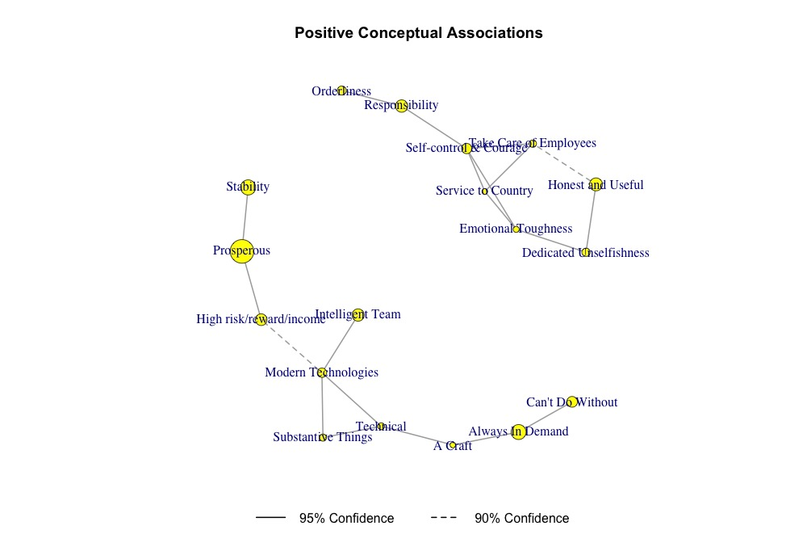

Slide 11
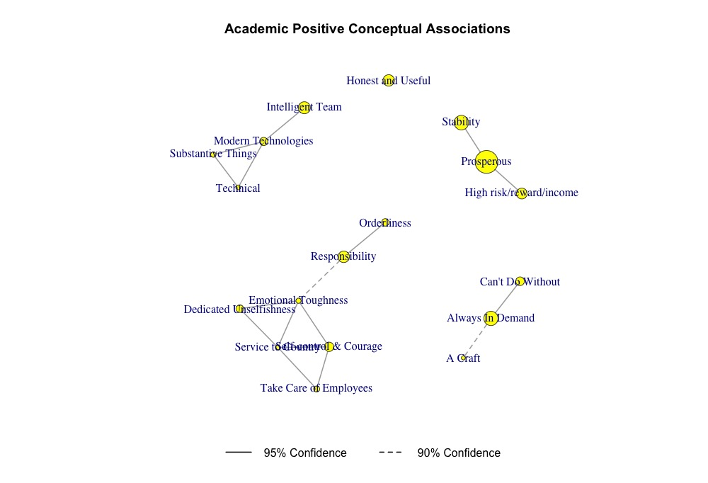

Slide 12
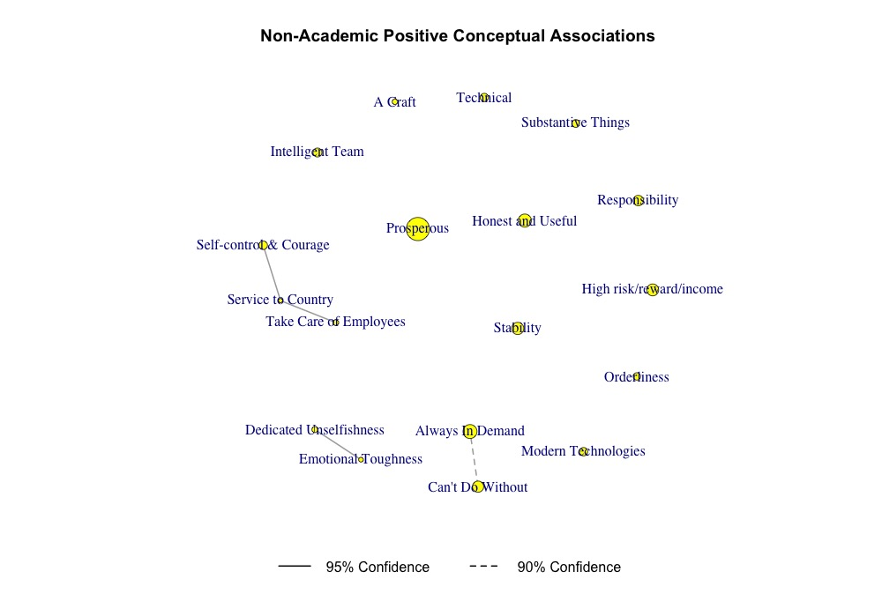

Slide 13
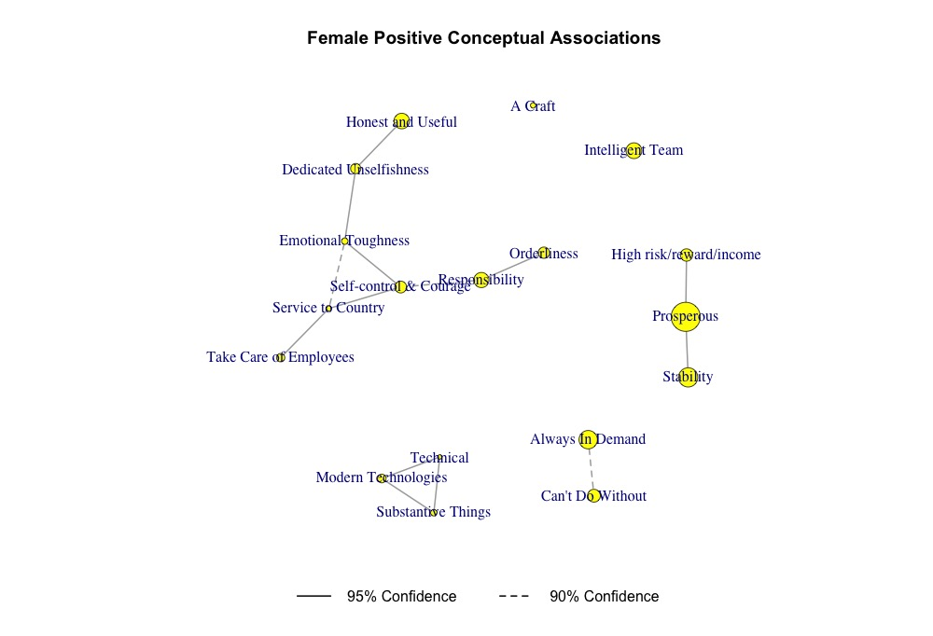

Slide 14
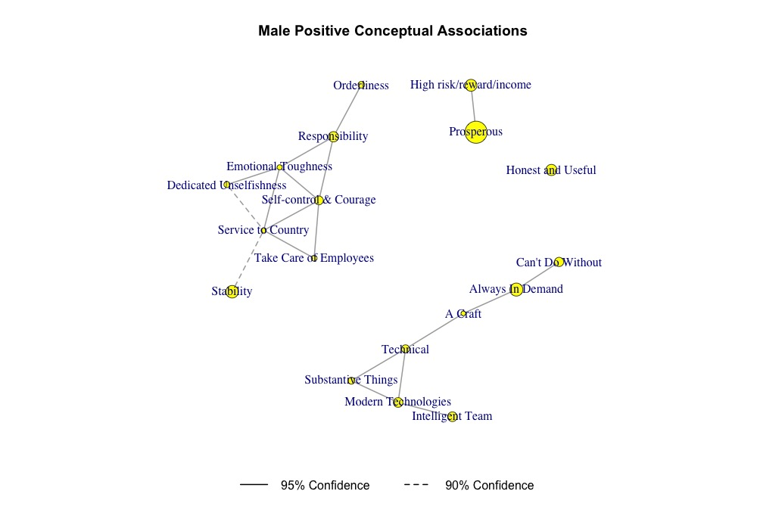

Slide 15
Conclusions and future work

Slide 16
Thank you!

